Slide 1
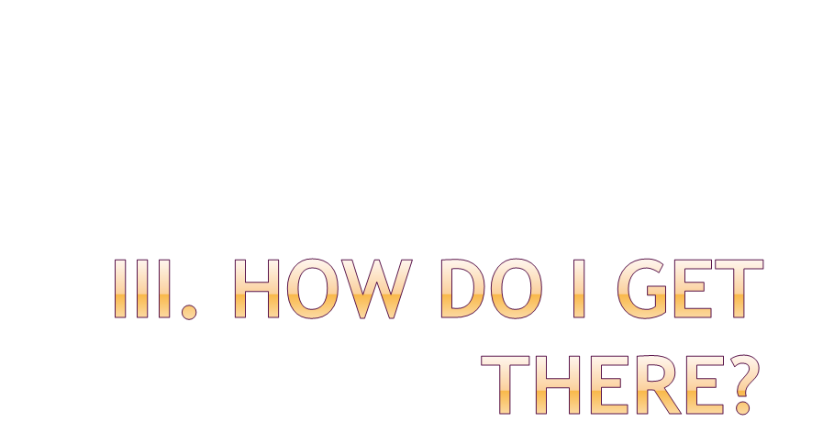
Topic 6: The Good Life

Slide 2

What is virtue?
Why try to live the virtues?
What is a virtuous life?
Types of virtues

Slide 3

Moral excellence
A good operative habit
Habit involving choice, lying in a mean identified by the intellect
Habit which makes a person good and makes his acts good

Slide 4

Moral Excellence
Human Person
Good Habit
Human powers/faculties
Good Acts
Acts of human faculties

Slide 5

To breathe
To digest
To read for exam
To tell the truth
To love a new acquaintance
To enjoy a bash
Involuntary / automatic
Involuntary / automatic
Not automatic (indetermined) / voluntary
Not automatic (indetermined) / voluntary
Human powers/faculties
Type of Human Act

Slide 6

We don’t necessarily / always choose truly good actions
We need to educate our various faculties (intellect, will, sentiments, etc.) so that they incline towards truly good objects
By learning to use our freedom wisely!

Slide 7

Happiness!
To develop all our potential as persons
To exercise genuine leadership
To be successful in life
To influence others positively
To find meaning and purpose in life!
Inner peace and harmony

Slide 8

Which of these characteristics would you like to see in a leader?
apathetic
imitator
Open mind
authentic
sacrificial
controlling
committed
empowering
selfish
generous

Slide 9

YES!!!
NO!!!

Slide 10
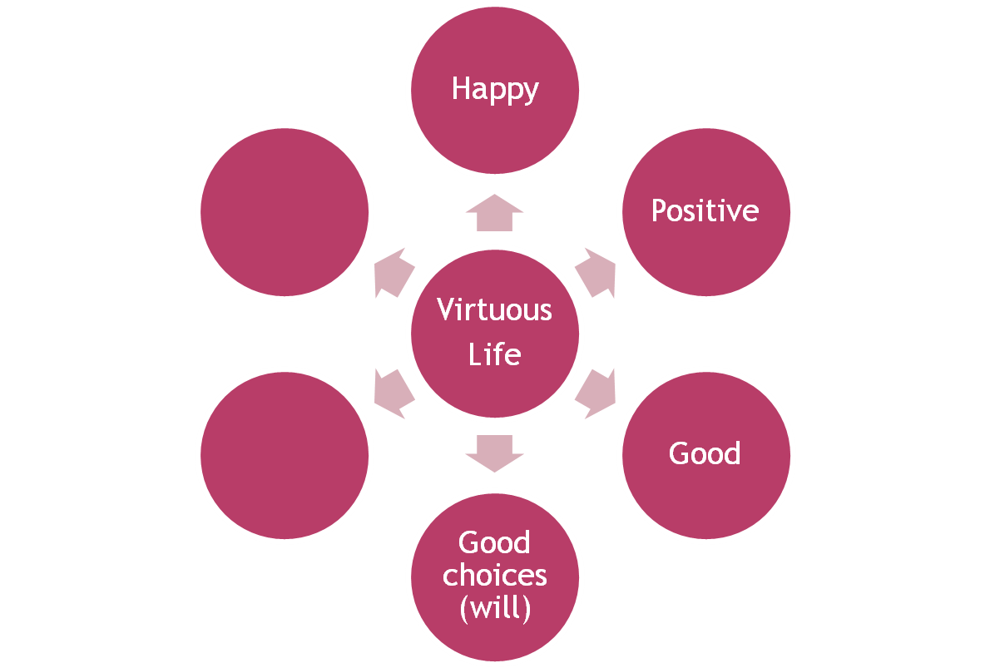
Internal acts
Good
actions
External acts
Good
Intentions
(intellect)
Notes:
WHAT IS GOOD LIFE ACCORDING TO ARISTOTLE?

Slide 11

Reside in and perfect theoretical and practical reason (intellect)
  Intellectus
  Synderesis theoretical
  Wisdom
  Knowledge
  Prudence practical
  Art/technology
Develop in and perfect the will and the sensitive tendencies
Perfect the inclinations of our appetites (desires, etc)
Infuse our desires, impulses and will with rationality
Practical truth that facilitates good actions
Intellectual – built by rationality
Moral – built by habit/will

Slide 12

Mimbi, pp. 169 – 177
Debeljuh, pp.

